Slide 1


Lecture 1-1
DLI
Points, Located Vectors and Scalar Product
空间中的点，向量和数量积

Slide 2
DLI
The assessments for MA1114
Jintao Zhang (Associate Professor)
18642098327 (Wechat)
zjt@dlut.edu.cn
DUT System | Assessments | DUT Mark | UoL Mark | UoL System
Linear Algebra I Sem 1 | Course Work | 30% | 10% | MA1114 Linear Algebra Year-Long
 | Examination | 70% | 30%
Linear Algebra II Sem 2 | Course Work | 30% | 10%
 | Examination | 70% | 50%

Slide 3
DLI
Outline
Points in Space 空间中的点；
Located Vectors in Space 空间中的向量；
Scalar Product 数量积；

Slide 4
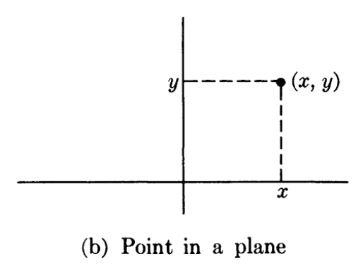
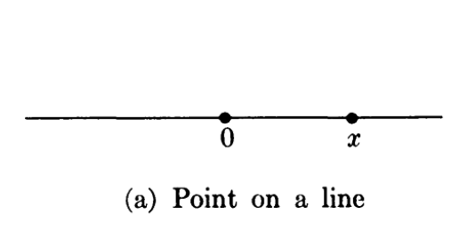
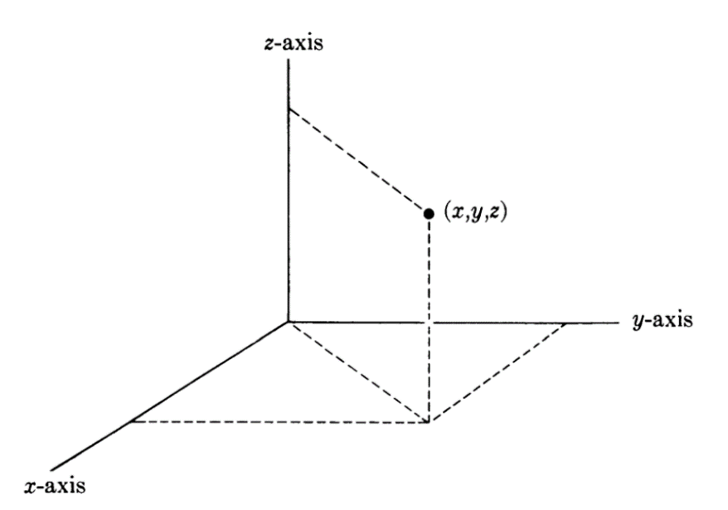
DLI
Points in Spaces
We know that a number can be used to represent a point
on a line, once a unit length is selected.
A pair of numbers (x, y) can be used to represent a point
in the plane.
A triple of numbers (x, y, z) can be used to represent a
point in space, that is 3-dimensional space, or 3-space

Slide 5
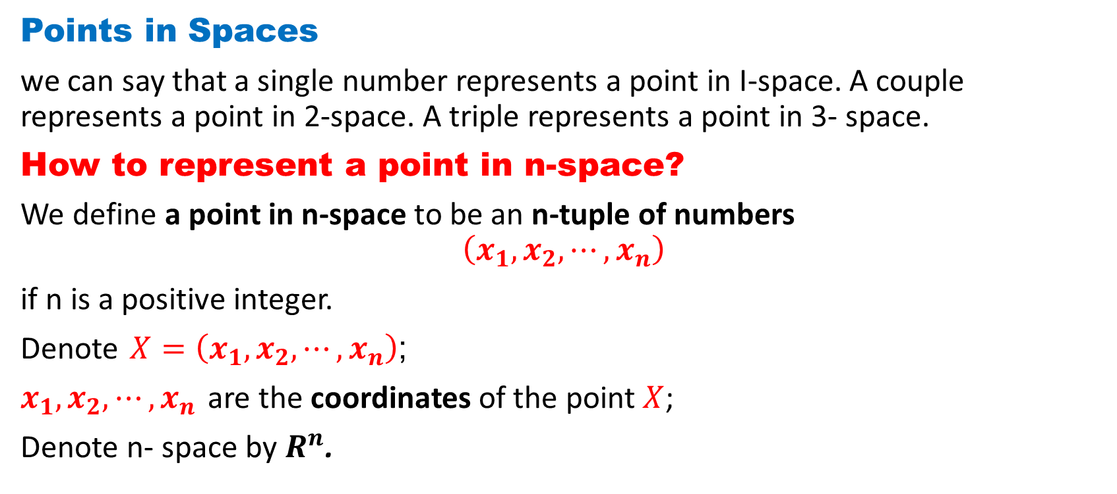
DLI
Points in Spaces
we can say that a single number represents a point in I-space. A couple represents a point in 2-space. A triple represents a point in 3- space.
How to represent a point in n-space?
We define a point in n-space to be an n-tuple of numbers
$$\left(x_{1},x_{2},⋯,x_{n}\right)$$
if n is a positive integer.
Denote $X=\left(x_{1},x_{2},⋯,x_{n}\right)$;
$x_{1},x_{2},⋯,x_{n}$ are the coordinates of the point $X$;
Denote n- space by $R^{n}$.

Slide 6
DLI
Example 1.1
One classical example of 3-space is of course the space we live in. After we have selected an origin and a coordinate system, we can describe the position of a point (body, particle, etc.) by 3 coordinates. Furthermore, as was known long ago, it is convenient to extend this space to a 4-dimensional space, with the fourth coordinate as time, the time origin being selected, say, as the birth of Christ-although this is purely arbitrary (it might be more convenient to select the birth of the solar system, or the birth of the earth as the origin, if we could determine these accurately). Then a point with negative time coordinate is a BC point, and a point with positive time coordinate is an AD point.
Note: Don't get the idea that "time is the fourth dimension ", however. The above 4-dimensional space is only one possible example.

Slide 7
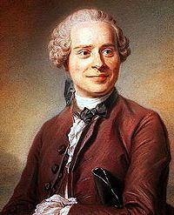
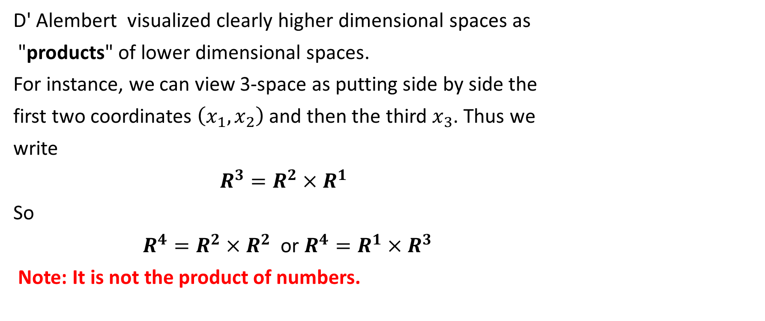
DLI
D' Alembert visualized clearly higher dimensional spaces as
"products" of lower dimensional spaces.
For instance, we can view 3-space as putting side by side the
first two coordinates $\left(x_{1},x_{2}\right)$ and then the third $x_{3}$. Thus we
write
$R^{3}=R^{2}×R^{1}$
So
$R^{4}=R^{2}×R^{2}$ or $R^{4}=R^{1}×R^{3}$
Note: It is not the product of numbers.
Jean le Rond d'Alembert

Slide 8
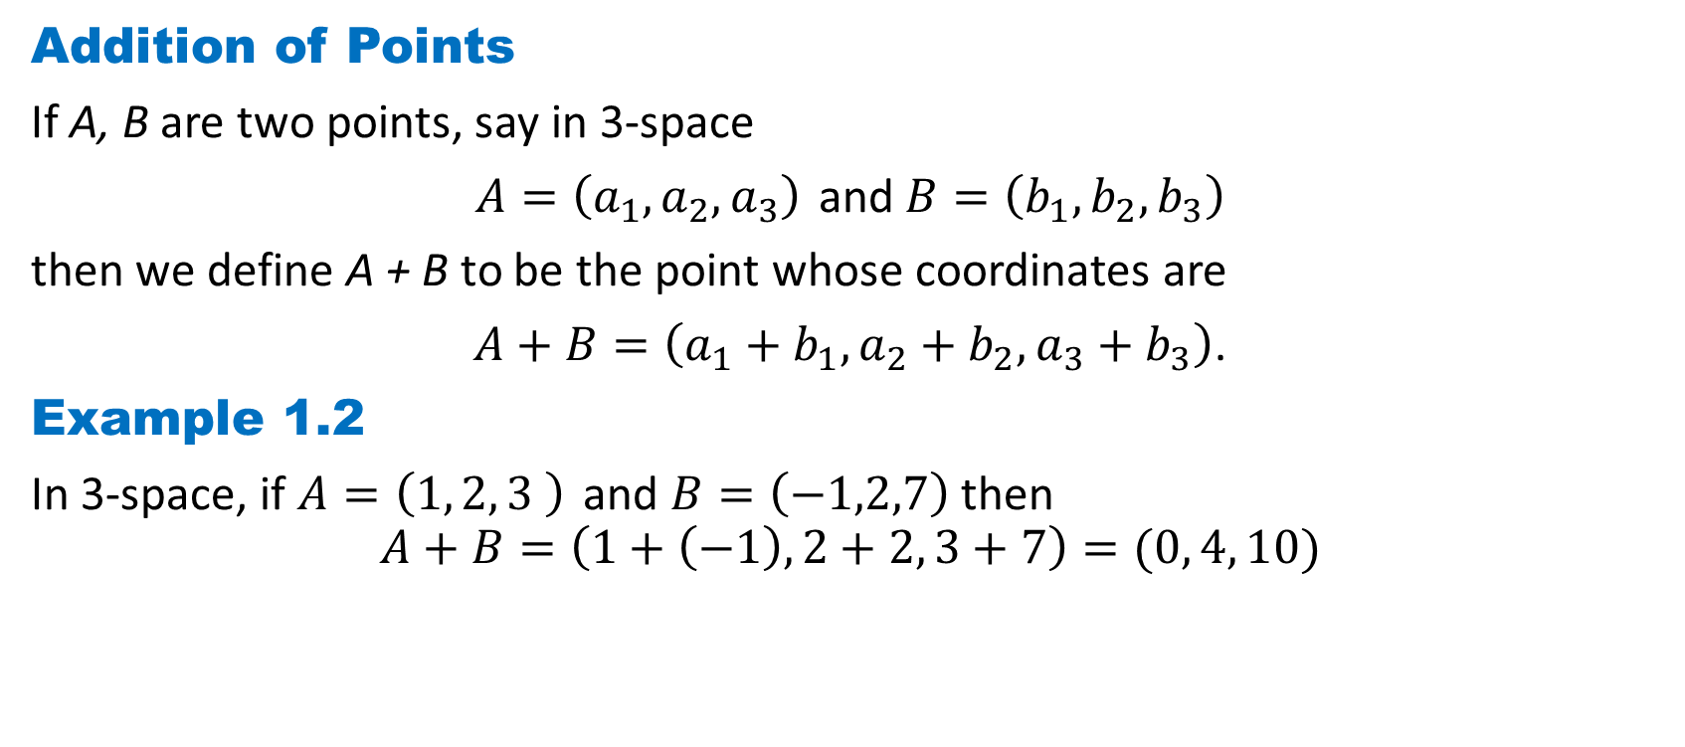
DLI
Addition of Points
If A, B are two points, say in 3-space
$A=\left(a_{1},a_{2},a_{3}\right)$ and $B=\left(b_{1},b_{2},b_{3}\right)$
then we define A + B to be the point whose coordinates are
$A+B=\left(a_{1}+b_{1},a_{2}+b_{2},a_{3}+b_{3}\right)$.
Example 1.2
In 3-space, if $A=\left(1, 2, 3 \right)$ and $B=\left(−1,2,7\right)$then
$$A+B=\left(1+\left(−1\right), 2+2, 3+7\right)=(0, 4, 10)$$

Slide 9
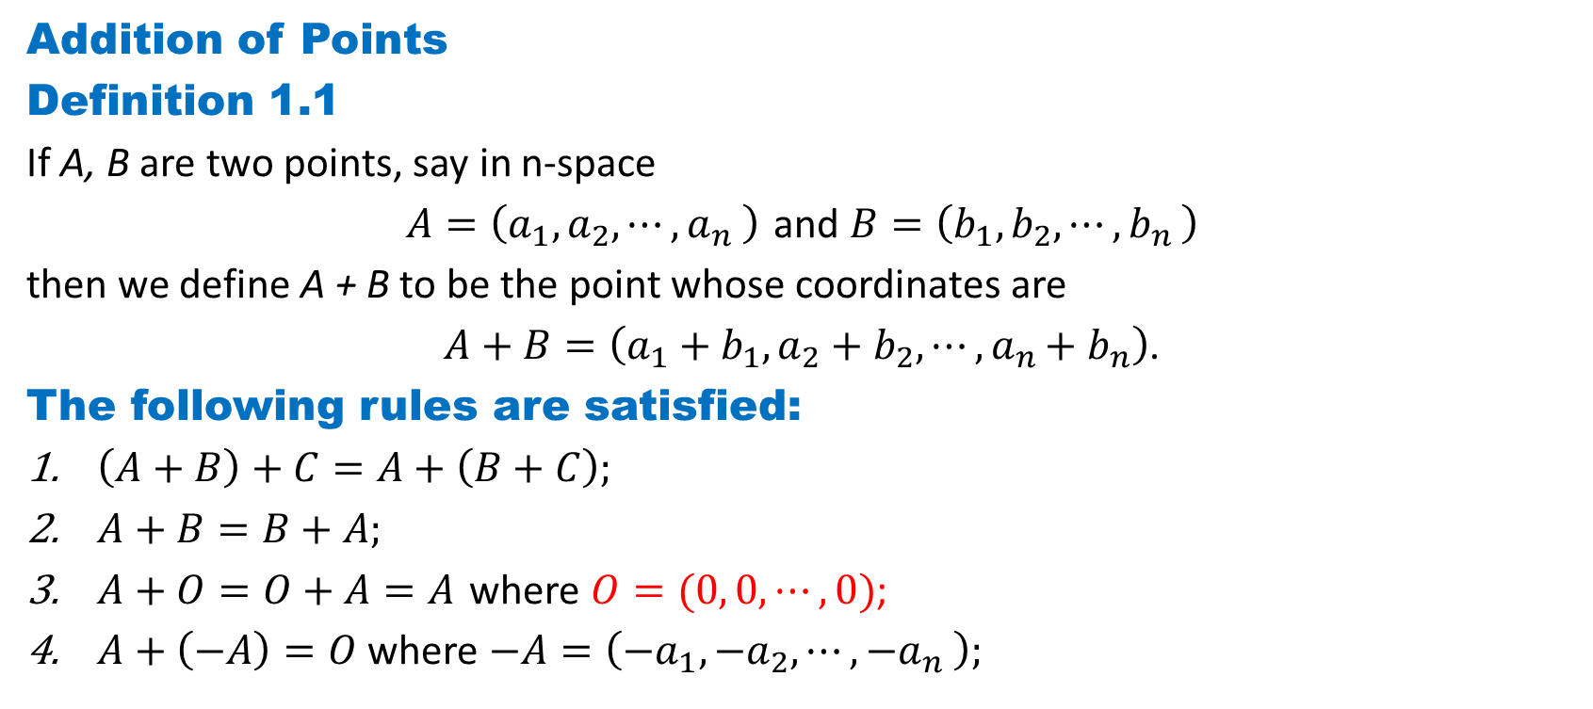
DLI
Addition of Points
Definition 1.1
If A, B are two points, say in n-space
$A=\left(a_{1},a_{2},{⋯,a}_{n}\right)$ and $B=\left(b_{1},b_{2},{⋯,b}_{n}\right)$
then we define A + B to be the point whose coordinates are
$A+B=\left(a_{1}+b_{1},a_{2}+b_{2},{⋯,a}_{n}+b_{n}\right)$.
The following rules are satisfied:
$\left(A+B\right)+C=A+\left(B+C\right);$
$A+B=B+A;$
$A+O=O+A=A$ where $O=(0, 0,⋯,0)$;
$A+\left(−A\right)=O$ where $−A=\left(−a_{1},−a_{2},{⋯,−a}_{n}\right);$

Slide 10
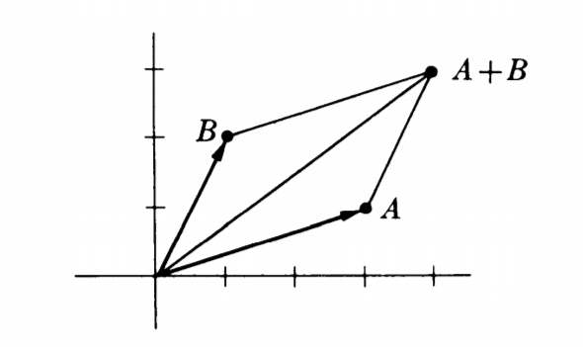
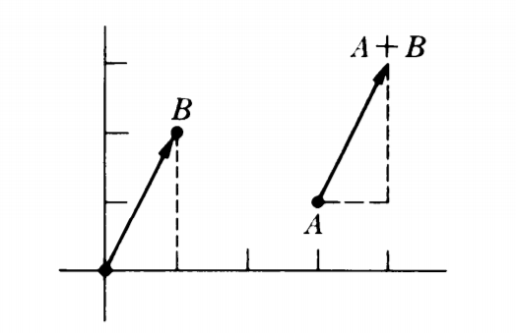

DLI
Example 1.3
Let $A=(3, 1)$ and $B=\left(1, 2\right).$ Then $A+B=\left(3+1, 1+2\right)=\left(4, 3\right).$
The geometric representation of our addition looks like a parallelogram.

Slide 11
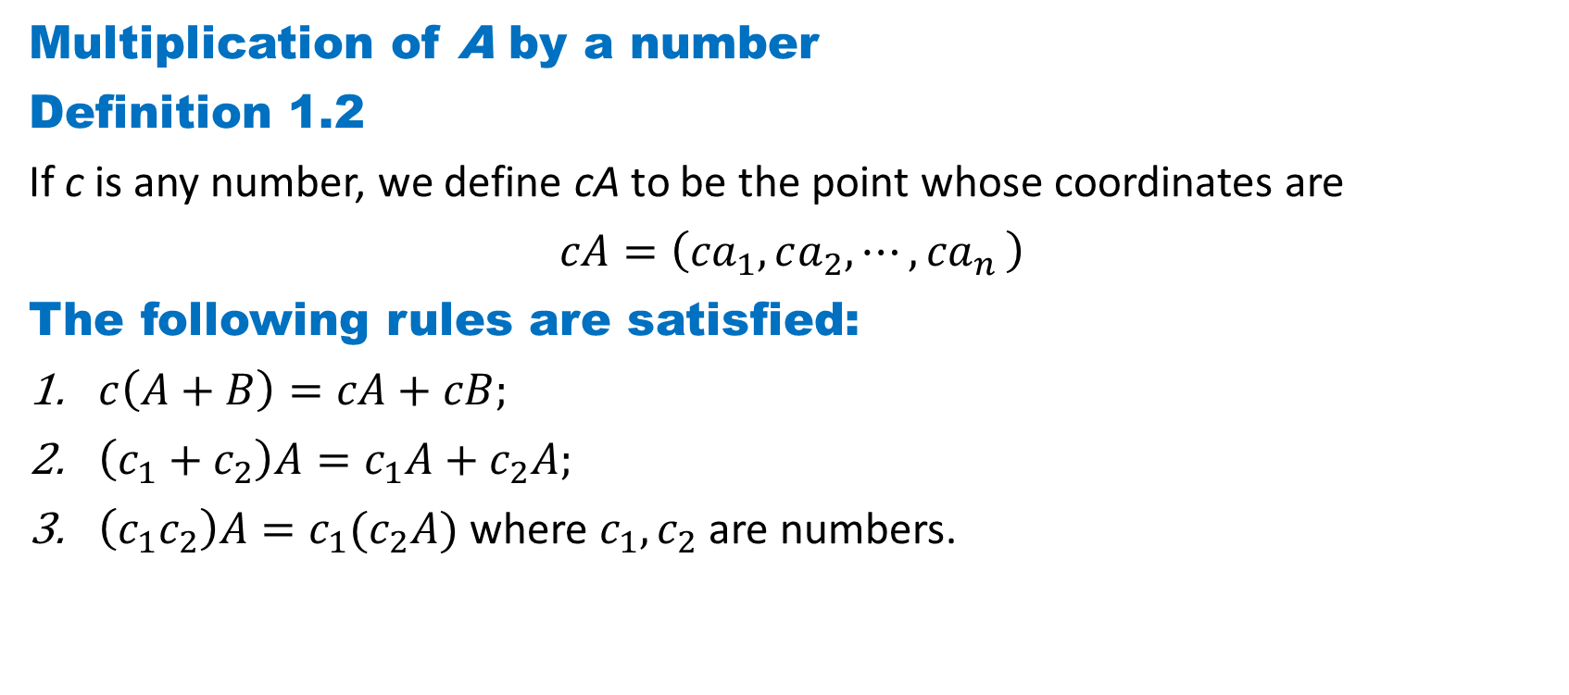
DLI
Multiplication of A by a number
Definition 1.2
If c is any number, we define cA to be the point whose coordinates are
$cA=\left({ca}_{1},ca_{2},{⋯,ca}_{n}\right)$
The following rules are satisfied:
$c\left(A+B\right)=cA+cB;$
$\left(c_{1}+c_{2}\right)A=c_{1}A+c_{2}A;$
$\left(c_{1}c_{2}\right)A={c_{1}(c}_{2}A)$ where $c_{1},c_{2}$ are numbers.

Slide 12
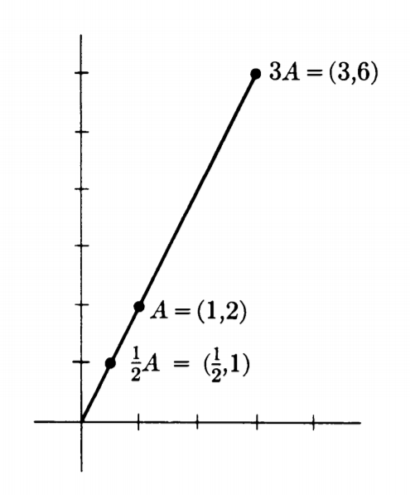

DLI
Example 1.4
Let $A=(1, 2)$ and $c=3.$
Then $B=cA=3\left(1, 2\right)=\left(3, 6\right).$
What is the geometric representation of
Multiplication by a number?
$c>0$ A and B have the same direction
with respect to the origin.
$c<0$ A, B (neither of which is zero) have
opposite directions

Slide 13
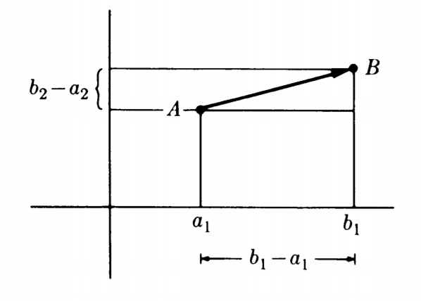
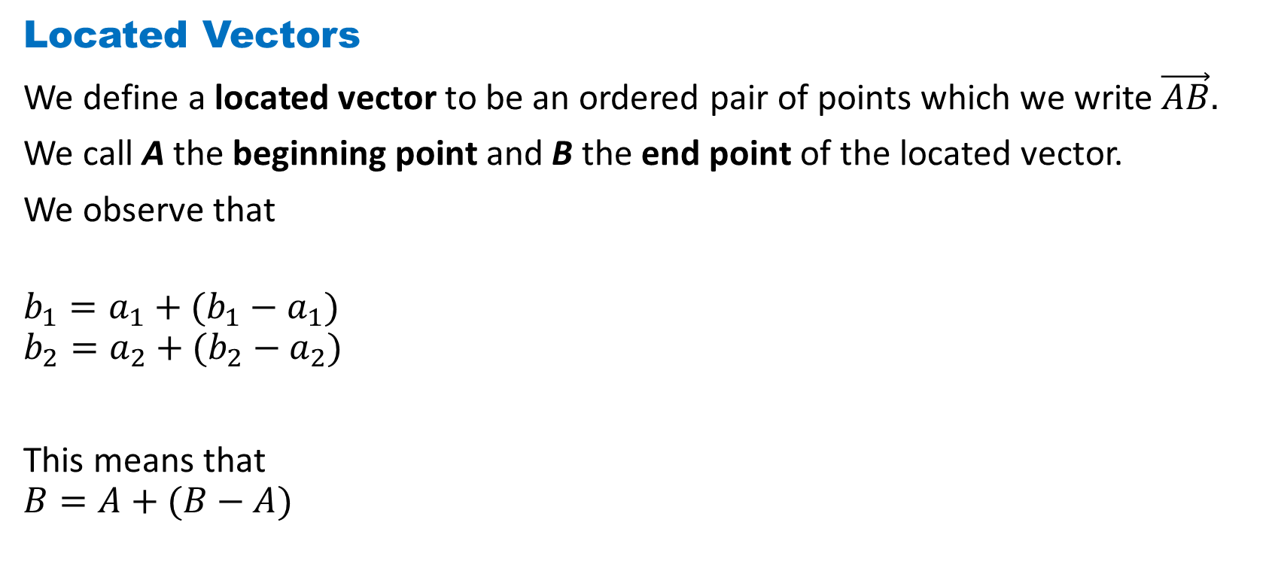
DLI
Located Vectors
We define a located vector to be an ordered pair of points which we write $\vec{AB}.$
We call A the beginning point and B the end point of the located vector.
We observe that
$$b_{1}=a_{1}+(b_{1}−a_{1})$$
$$b_{2}=a_{2}+(b_{2}−a_{2})$$
This means that
$$B=A+(B−A)$$

Slide 14
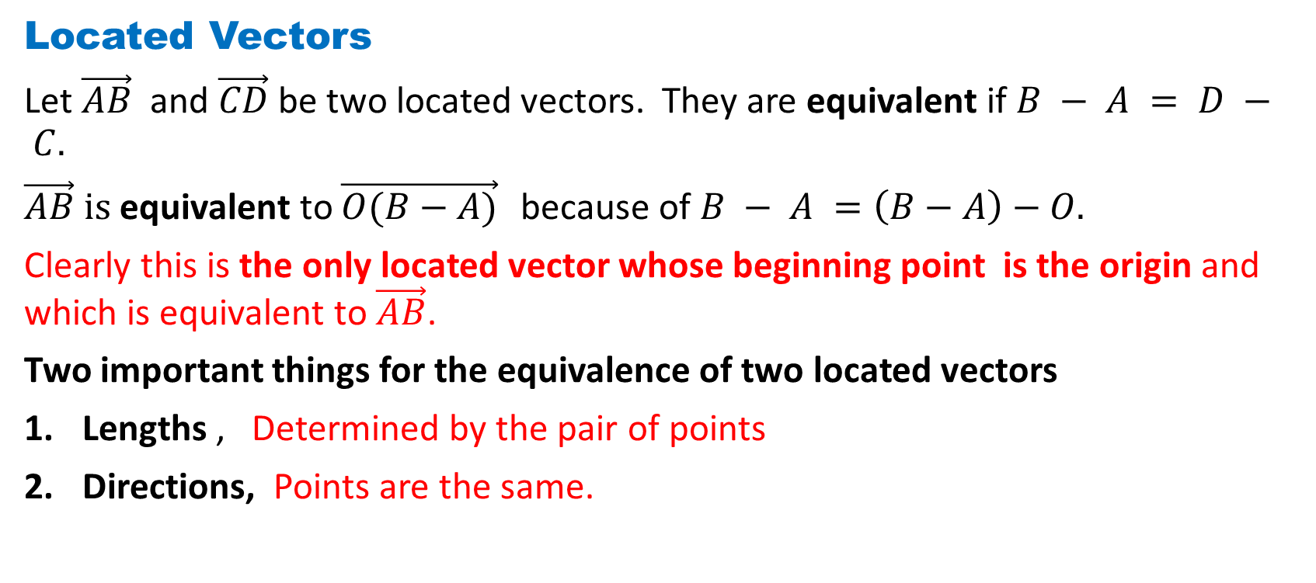
DLI
Located Vectors
Let $\vec{AB}$ and $\vec{CD}$ be two located vectors. They are equivalent if $B − A = D − C.$
$\vec{AB} is$ equivalent to $\vec{O(B−A)}$ because of $B − A =\left(B−A\right)−O.$
Clearly this is the only located vector whose beginning point is the origin and which is equivalent to $\vec{AB}$.
Two important things for the equivalence of two located vectors
Lengths , Determined by the pair of points
Directions, Points are the same.

Slide 15
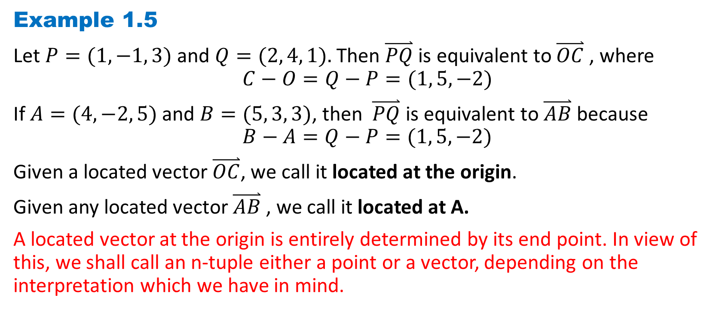
DLI
Example 1.5
Let $P=(1, −1, 3)$ and $Q=(2, 4, 1).$ Then $\overset{⃑}{PQ}$ is equivalent to $\overset{⃑}{OC}$ , where
$$C−O=Q−P=(1, 5, −2)$$
If $A=(4, −2, 5)$ and $B=(5, 3, 3)$, then $\overset{⃑}{PQ}$ is equivalent to $\overset{⃑}{AB}$ because
$$B−A=Q−P=(1, 5, −2)$$
Given a located vector $\overset{⃑}{OC}$, we call it located at the origin.
Given any located vector $\overset{⃑}{AB}$ , we call it located at A.
A located vector at the origin is entirely determined by its end point. In view of this, we shall call an n-tuple either a point or a vector, depending on the interpretation which we have in mind.

Slide 16
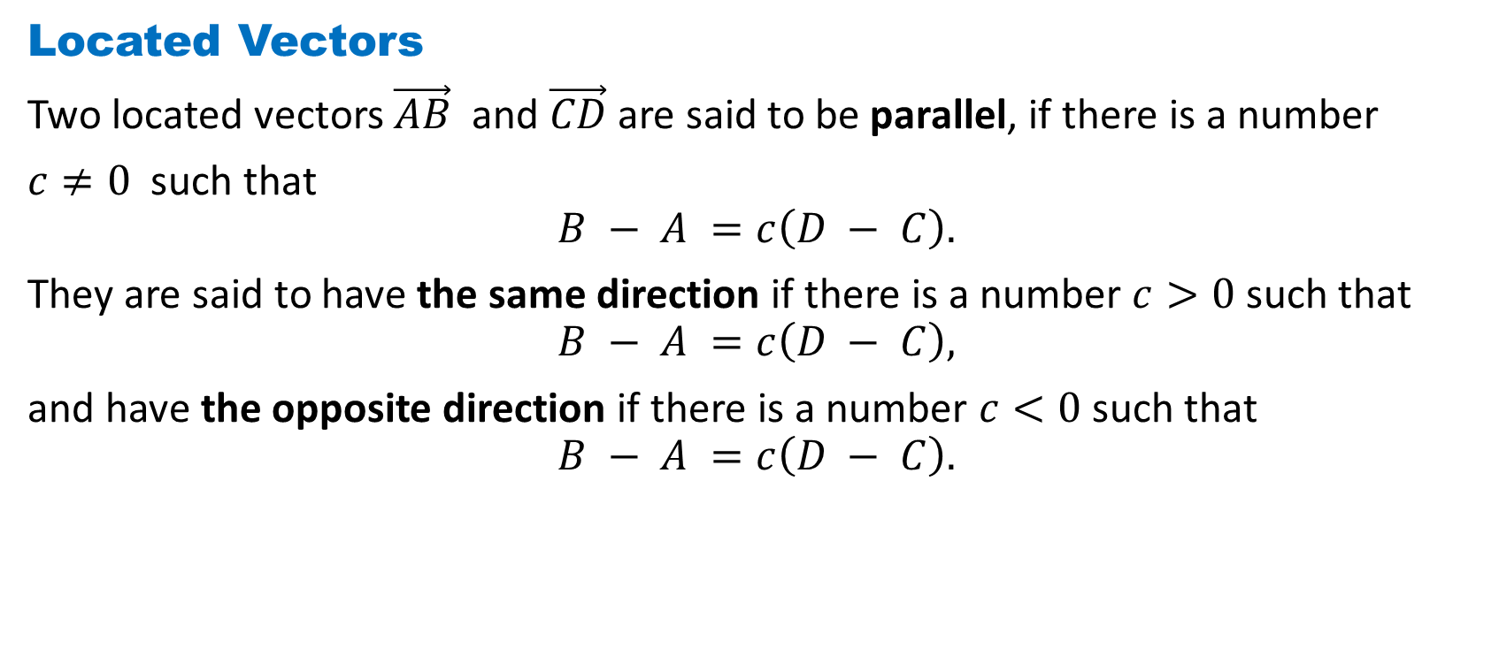
DLI
Located Vectors
Two located vectors $\vec{AB}$ and $\vec{CD}$ are said to be parallel, if there is a number
$c≠0$ such that
$$B − A =c\left(D − C\right).$$
They are said to have the same direction if there is a number $c>0$ such that
$$B − A =c\left(D − C\right),$$
and have the opposite direction if there is a number $c<0$ such that
$$B − A =c\left(D − C\right).$$

Slide 17
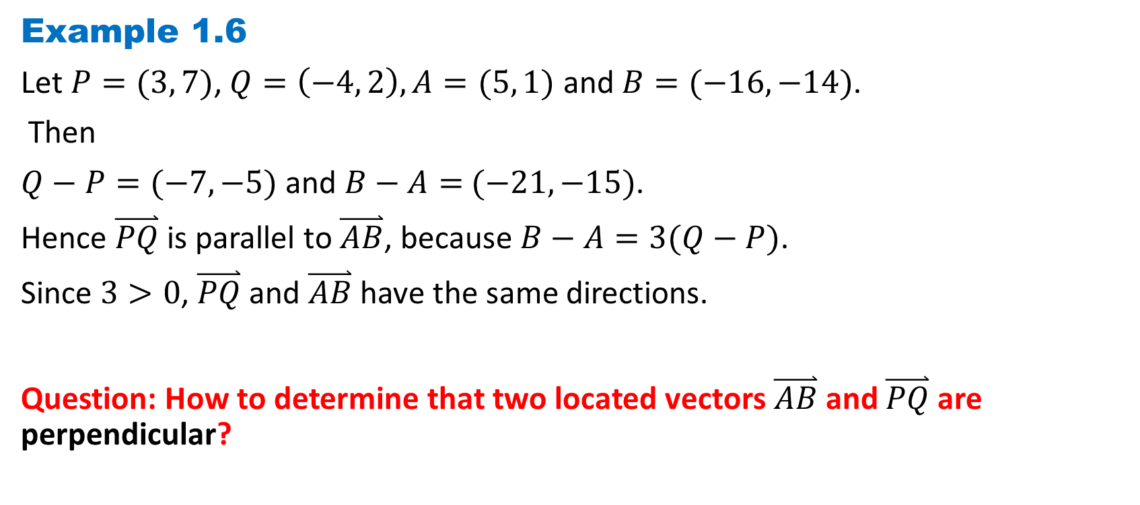
DLI
Example 1.6
Let $P=(3, 7)$, $Q=\left(−4, 2\right), A=(5, 1)$ and $B=(−16, −14)$.
Then
$Q−P=(−7, −5)$ and $B−A=$ $(−21, −15)$.
Hence $\overset{⃑}{PQ}$ is parallel to $\overset{⃑}{AB}$, because $B−A=3(Q−P)$.
Since $3>0$, $\overset{⃑}{PQ}$ and $\overset{⃑}{AB}$ have the same directions.
Question: How to determine that two located vectors $\overset{⃑}{AB}$and $\overset{⃑}{PQ}$ are perpendicular?

Slide 18
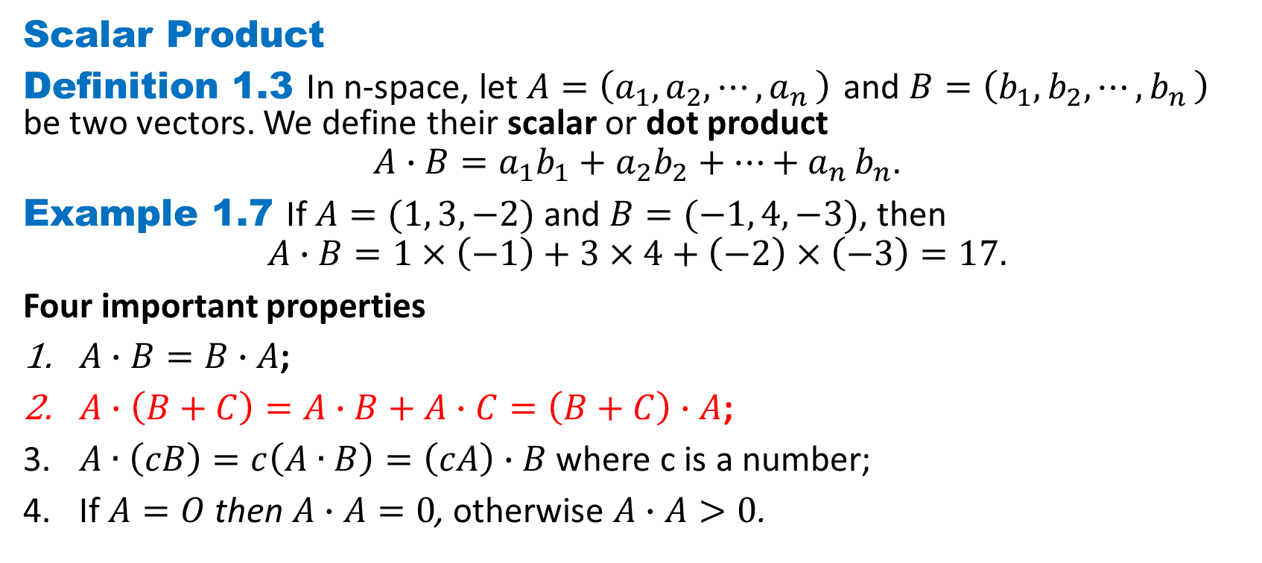
DLI
Scalar Product
Definition 1.3 In n-space, let $A=\left(a_{1},a_{2},{⋯,a}_{n}\right)$ and $B=\left(b_{1},b_{2},{⋯,b}_{n}\right)$ be two vectors. We define their scalar or dot product
$$A∙B=a_{1}b_{1}+a_{2}b_{2}+{⋯+a}_{n}b_{n}.$$
Example 1.7 If $A=(1, 3,−2)$ and $B=(−1, 4,−3)$, then
$$A∙B=1×\left(−1\right)+3×4+\left(−2\right)×\left(−3\right)=17.$$
Four important properties
$A∙B=B∙A$;
$A∙\left(B+C\right)=A∙B+A∙C=\left(B+C\right)∙A$;
$A∙\left(cB\right)=c\left(A∙B\right)=\left(cA\right)∙B$ where c is a number;
If $A=O$ then $A∙A=0$, otherwise $A∙A>0$.

Slide 19
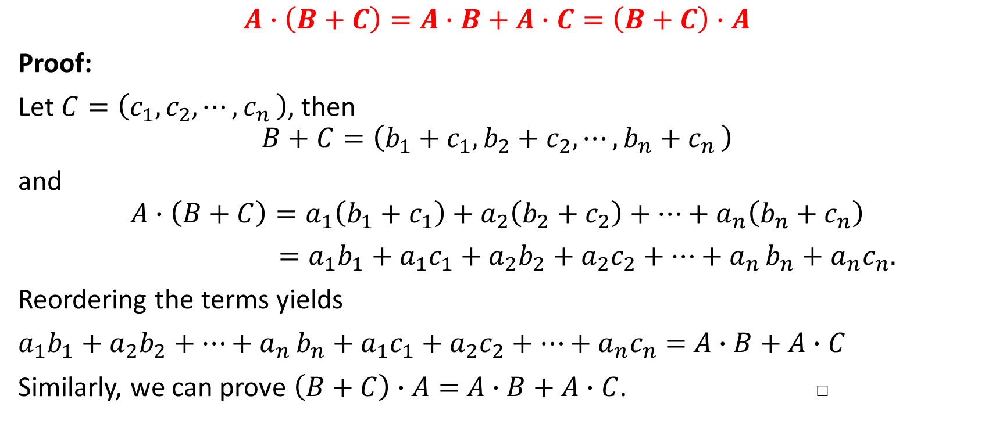
DLI
$$A∙\left(B+C\right)=A∙B+A∙C=\left(B+C\right)∙A$$
Proof:
Let $C=\left(c_{1},c_{2},{⋯,c}_{n}\right)$, then
$$B+C=\left({b_{1}+c}_{1},{b_{2}+c}_{2},{⋯,b_{n}+c}_{n}\right)$$
and
$$A∙\left(B+C\right)=a_{1}\left({b_{1}+c}_{1}\right)+a_{2}\left({b_{2}+c}_{2}\right)+⋯+a_{n}\left({b_{n}+c}_{n}\right)$$
$=a_{1}b_{1}+a_{1}c_{1}+a_{2}b_{2}+a_{2}c_{2}+{⋯+a}_{n}b_{n}+a_{n}c_{n}.$
Reordering the terms yields
$a_{1}b_{1}+a_{2}b_{2}+{⋯+a}_{n}b_{n}+a_{1}c_{1}+a_{2}c_{2}+⋯+a_{n}c_{n}=$ $A∙B+A∙C$
Similarly, we can prove $\left(B+C\right)∙A=$ $A∙B+A∙C$. □

Slide 20
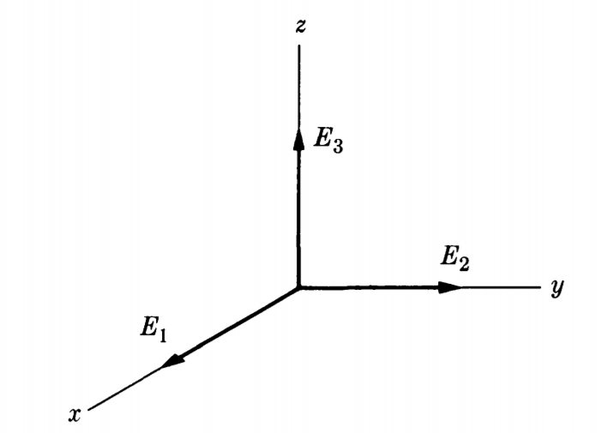
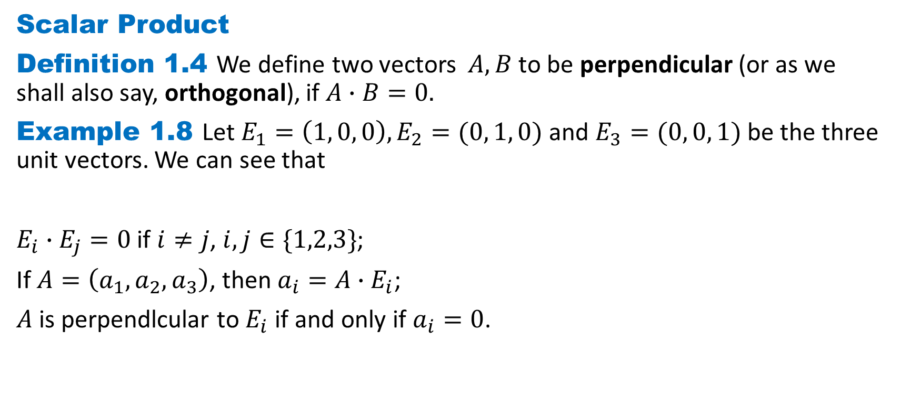
DLI
Scalar Product
Definition 1.4 We define two vectors $A,B$ to be perpendicular (or as we shall also say, orthogonal), if $A∙B=0.$
Example 1.8 Let $E_{1}=\left(1, 0, 0\right), E_{2}=(0, 1, 0)$ and $E_{3}=(0, 0, 1)$ be the three unit vectors. We can see that
$E_{i}∙E_{j}=0$ if $i≠j$, $i,j∈\{1,2,3\}$;
If $A=\left(a_{1},a_{2},a_{3}\right)$, then $a_{i}=A∙E_{i}$;
$A$ is perpendlcular to $E_{i}$ if and only if $a_{i}=0$.

Slide 21
DLI
Homework 1-1
Exercise 1.1 Page 8
Q7
Exercise 1.2 Page 12
Q3, Q8
Exercise 1.3 Page 15
Q5

